Slide 1
Group 3: GAI for Education
Michael Soebroto, Mohnish Sai Prasad, Rithesh Kumar
Bi-weekly Update Week 5

Slide 2
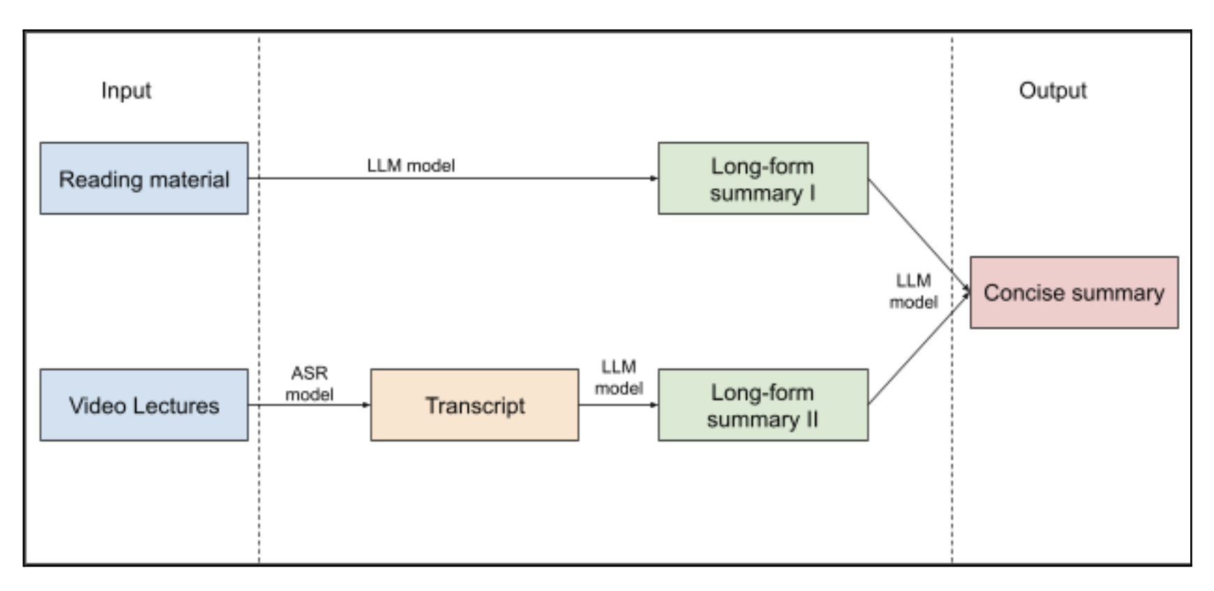
Project Background
Problem: There a large amount of course material out there and it is time consuming to go through. Students often have a very short attention-span for tasks like these which causes inefficient learning.
Goal: Condense learning material into shortened content in order to improve the learning experience.
Solution: We aim to create a tool that turns a collection of video lectures and reading material into a more consumable format.

Slide 3
Project Status
Current status
Slightly behind schedule
Changes from last time
Built the pipeline for summarization from video content using Zero-Shot learning.
Found associated reading material for the majority of the data-set.
Tested the performance of different pre-trained models for summarization.
Plan for next cycle
Finish up the flow for reading material summarization
Work on a LLM model that creates a more concise summary of both material
Begin fine-tuning fit the problem once the base model is finished.

Slide 4
Individual Status
Team Member | What I did in the last two weeks
Michael | Built the Evaluation Model code that scores summaries based on Rouge, BertScore and G-Eval Looked more into if G-Eval is a viable method and compare it to human annotations of model-generated summaries (using CNN/DailyMail dataset)
Mohnish | Processed the video transcripts of the dataset into a input ready format for the model and generated summaries for these using the GPT 3.5 Turbo model (Zero Shot Learning) Used Wikipedia API to scrap reading content for most of the videos in the dataset For some videos (without Wiki content), manually searched and found reading material
Rithesh | Compared the performance of evaluators - G-Eval, Rouge and BertScore with the help of human generated summaries. Performed Zero-shot learning on various existing models used for summarisation and analysed their performance on the datasets. Building the pipeline for the project.

Slide 5
Overall Schedule
Project Progress (Milestones Achieved)
Built the Video Lecture Summarization flow using Zero-Shot learning.
Tested G-Eval to determine quality of evaluation vs other evaluation metrics with the help of standard datasets (SummEval)
Examined the performance of different pre-trained models from HuggingFace.
Updated Timeline
Week 5: Finish up the pipeline for Reading Material summarization and the overall flow of the baseline model + fix on the evaluation criteria for G-EVAL
Weeks 6-7: Building and fine-tuning models to fit the problem, involving testing and comparing with the baseline performance.
Week 8: Testing and fixing the entire workflow.
Week 9: (Buffer) Improvements / extra features
Week 10: Final touches and presentation

Slide 6
Interesting Findings
G-Eval as an evaluator shows a lot of variance with the average human evaluator, however, has some correlation with the expert evaluation
The human annotations of EDUVSUM are not as expected.
Annotations consisted of a set of scores that represent the importance of frames within the video
Since the video topics in the dataset are from a variety of educational domains, direct reading material for some of the topics weren’t available
Hence reading material for those were sourced based upon some of the related concepts in the video
In measuring the performance of the pre-trained models, we found that Pegasus model (Google) has the best performance over the Rouge and BertScore metrics.
Evaluation metrics:
Rouge score captures the similarity between the words present in the summaries, which doesn’t help much for generative summaries
BertScore does some context based summarisation with contextual embeddings and using the BERT model, but not a good measure for subtleties and high-level understanding.
G-EVAL uses GPT-4 model to score the summary based on a few evaluation metrics (Relevance, Coherence, Consistency, Fluency) but it’s highly sensitive on the evaluation criteria and rules given.
Notes:
Stuff to note:
Experimental results
New model architectures
Insights into data
Graphs and statistics
Annotation/labeling insights
Any finding that is worth sharing with class
Should have some new content every week
Any challenges or questions

Slide 7
Thank You

